Slide 1
Lists #1
A supplemental lesson for AP CSP

Slide 2
Warm-up
Make a to-do list. It can be a list of:
Things you need to do today
Things to do to be healthy
Things you need to do for a school project
After school or weekend activities
Anything else you want to make a list for

Slide 3

Warm-up
Compare your list with other groups.
Do you have the same number of items?
Did you write the list in the same way?
Do your lists have a particular order?

Slide 4
Warm-up
Think about writing a program for the to-do list.
How would you handle all the items on your list?
If you use variables, how many would you need?
Could your program work if you had more items or fewer items on your list?

Slide 5
Warm-up
Wouldn’t it be helpful if there was a data structure that let you handle multiple similar items?
There is! It is a list (also called an array).
A list is like a variable that can hold one or more values.
Definition: A list is an ordered collection of elements (items).
A list is a type of data abstraction.

Slide 6
Data Abstraction
AP CSP Big Idea #3 - Algorithms and Programming
AAP-1.D.a: Develop data abstraction using lists to store multiple elements.
AAP-1.D.b: Explain how the use of data abstraction manages complexity in program code.
AAP-2.0.a: Write iteration statements to traverse a list.
AAP-2.0.b: Determine the result of an algorithm that includes list traversals.
AAP-3.B: Explain how the use of procedural abstraction manages complexity in a program.

Slide 7
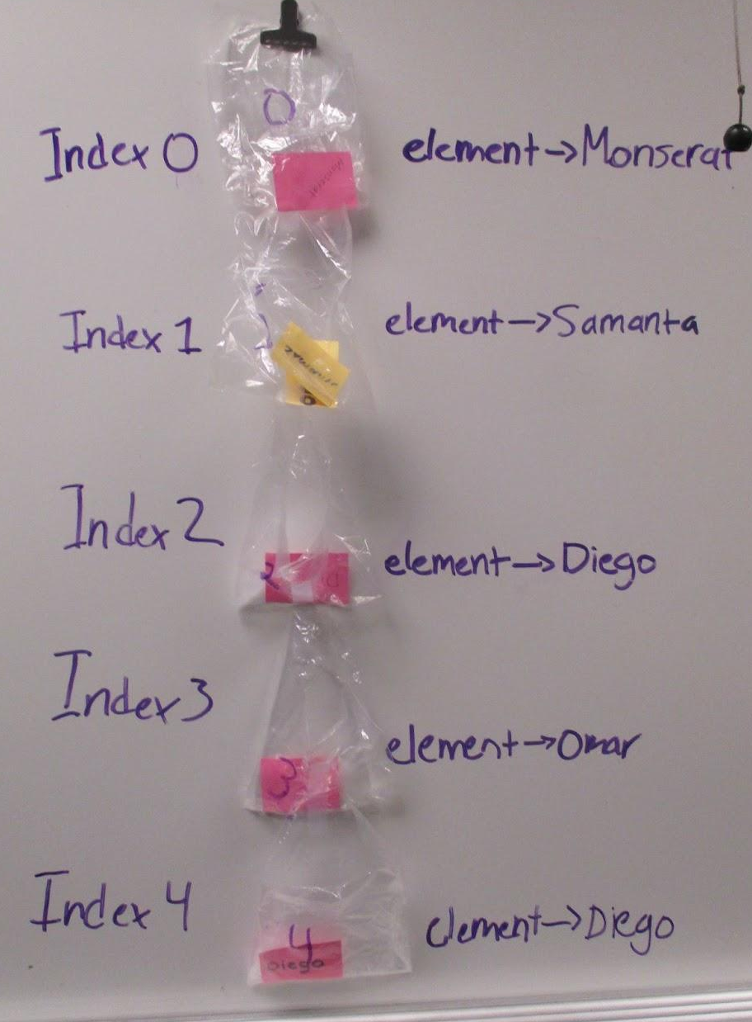
Example of a list
Look at your to-do list again.
Think of each item (element) as variable, stored in a baggie.
Put the baggies in order in a line.
Tape the baggies together, either top to bottom or side to side.
This string of variables together makes a list.

Slide 8
Data Abstraction
Lists allow us to name and work with with large collections of information with few variables. These programs are easier to develop and maintain.
In Python, a list is defined using square brackets.
names = [“Monserat”, “Samantha”, “Diego”, “Omar”, “Diego”]
todo_list = [“read a book”, “wash dishes”, “take shower”]
numbers = [1, 5, 3, 10, 12, 4]
colors_list = [RED, GREEN, BLUE, WHITE, CYAN, PINK, GRAY]

Slide 9
Example of a list
Look at your to-do list again.
Your list needs a name. A list name follows the same rules as other variable names.
Often a list name is in a plural form, to indicate it holds more than one element.
In Python the first element is referenced at index 0.
names =

Slide 10

Lists Vocabulary
A List is an ordered collection of elements
An index a common method for referencing the elements in a list or string using numbers
An Element (or item) is an individual value in a list that is assigned a unique index
The length of a list is how many elements it contains. Lists can grow or shrink as elements are added or removed.
len(fav_nums) = 3
Lists allow us to name and work with with large collections of information with few variables. These programs are easier to develop and maintain.
0 1 2
fav_nums = [74, 53, 22]
74
0
fav_nums
53
1
22
2

Slide 11
Definitions
A list is an ordered collection of elements (items).
An index is a number used to reference the element in a list and refers to its order in the list.
An element (or item) is an individual value in a list, and each is assigned a unique index.
The length of a list is how many elements it contains. Lists can grow or shrink als elements are added or removed.
names =

Slide 12
Definitions
A list is an ordered collection of elements (items).
An index is a number used to reference the element in a list and refers to its order in the list.
An element (or item) is an individual value in a list, and each is assigned a unique index.
The length of a list is how many elements it contains. Lists can grow or shrink als elements are added or removed.
0 1 2 3 4
names = [“Monserat”, “Samantha”, “Diego”, “Omar”, “Diego”]
len(names) = 5

Slide 13
Using a List
Define a list using square brackets.
alist = [ ]
  Defines an empty list
alist = [0, 1, 2, 3, 4, 5, 6, 7]
  Defines a list with 4 numbers
alist = [“Hello”, “Hi”, “Hey”, “What’s Up?”]
  Defines a list with four strings
alist = [pics.HOUSE, pics.TSHIRT, pics.HAPPY]
  Defines a list of three CodeX images

Slide 14
Using a List
Accessing and updating an element in a list
Next to the list name, use square brackets with the index:
numbers = [1, 2, 5, 9, 3]
my_num = numbers[1]
  Result: my_num = 2
my_num = numbers[3]
  Result: my_num = 9
my_num = numbers[5]
  Result: index out of range error
numbers[2] = numbers[4] + numbers[3]
  Result: numbers[2] = 12
numbers[0] = numbers[0] + 1
  Result: numbers[0] = 2

Slide 15
Using a List
These list methods are used on the AP Exam:
list.append(element) adds an element to the end of a list.
  The length of the list increases by 1.
list.insert(index, element) adds an element at the given index.
  The length of the list increases by 1.
  The index of all elements following the inserted element are increased by 1.
list.pop(index) removes an element at the given index.
  The length of the list decreases by 1.
  The index of all elements following the popped element are decreased by 1.

Slide 16
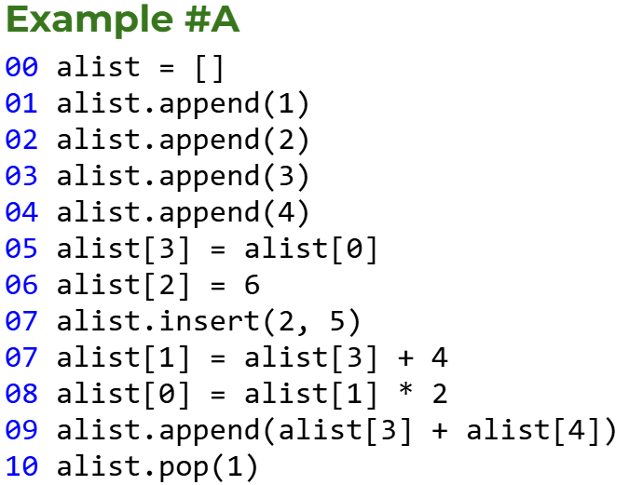
Try some code tracing with lists
  Get Example A code from your teacher.
  With your group, work through each problem.
  What is the final list after the code is executed?

Slide 17
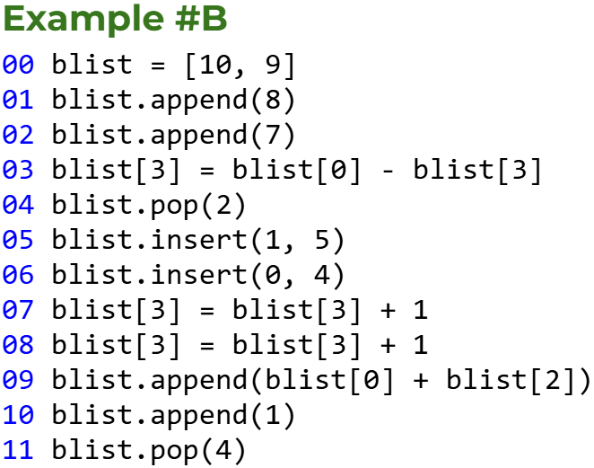
Try some code tracing with lists
  Get Example B code from your teacher.
  With your group, work through each problem.
  What is the final list after the code is executed?

Slide 18
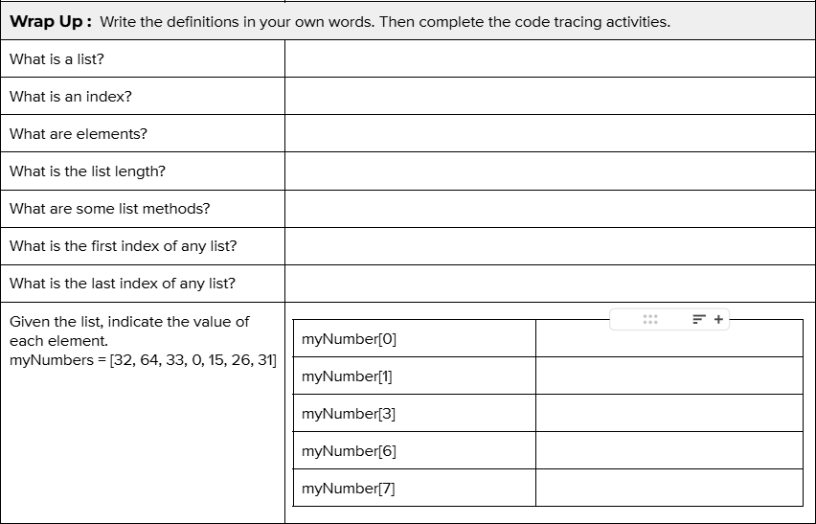
Wrap Up
  Complete the assignment, either individually or as a group.

